Slide 1
FREEBIES FOR NEWBIES
A place to find free event and items
Team Members:
Manoj Kumar Gude
Harish Chowdary Bala
Aditya Krishna Raavi
Jaichand Mulakalapalli
Saibabu Devarapalli
Client & Mentor:
Dr. Chandra Mouli Kotteti

Slide 2
Team Members
JAICHAND MULAKALAPALLI
(TEAM LEADER) BACKEND
MANOJ KUMAR GUDE
FRONTEND
ADITHYA KRISHNA RAAVI
FRONTEND
Saibabu devarapalli
Fullstack
HARISH CHOWDARY BALA
DATABASE
DR. CHANDRA MOULI KOTTETI
Mentor & Client

Slide 3
Table of Contents
Scroll View In Android
Action Bar (Navigation Bar)
Back4App Database
RecylerViews
Lessons Learned
Summary
Date Picker and Time Picker
Introduction

Slide 4




Introduction
Freebies for Newbies is an android application, which helps international students to access to free items and events in the desired location.
Tools and Design:
Android Studio - The tool used for the UI development.
GenyMotion - Emulator (Virtual device).
Git Hub - To integrate UI part and store it.
Oracle VirtualBox - Its an essential tool required to run for GenyMotion.
Back4App - Database.
Programming Language:
Java.

Slide 5
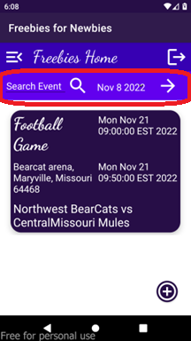
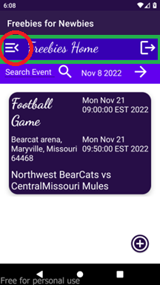
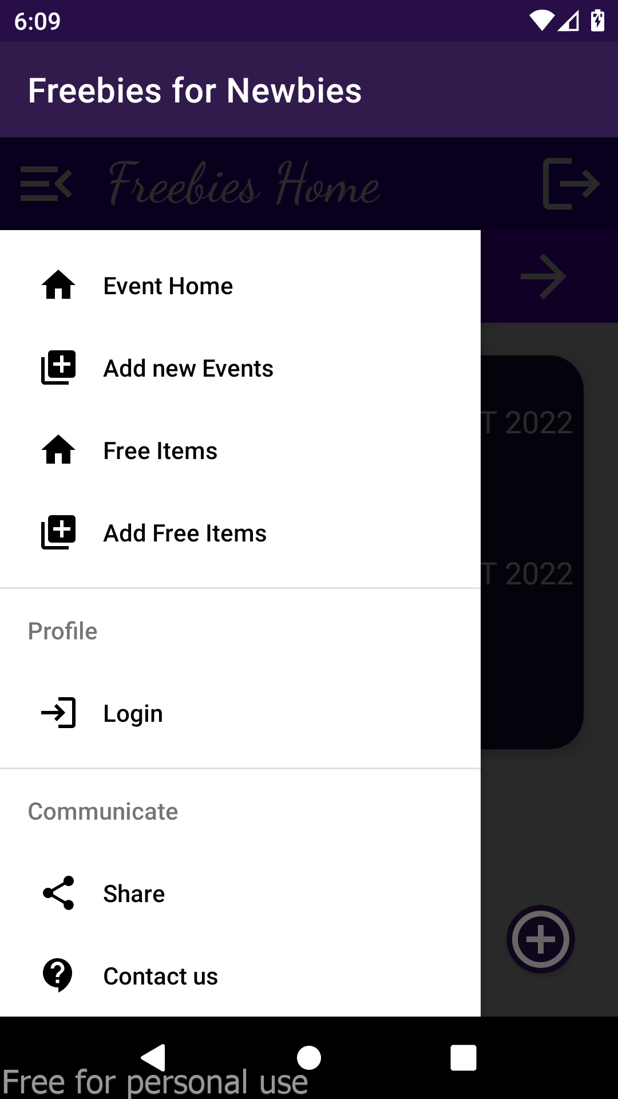
Action Bar (Navigation Bar)
An Action Bar is a place to display navigational controls, Controls to support switching from one view to another using menu options.
Fig. 1: Search toolbar and Navigation bar with different controls like menu options, home, logout etc.,

Slide 6
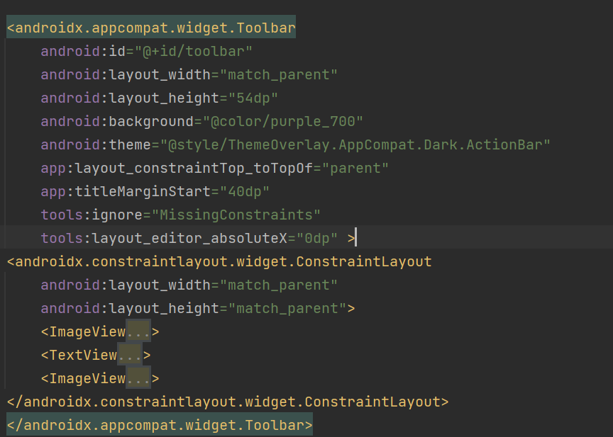
Action Bar (Navigation Bar)
Fig. 2: Navigation bar XML code

Slide 7
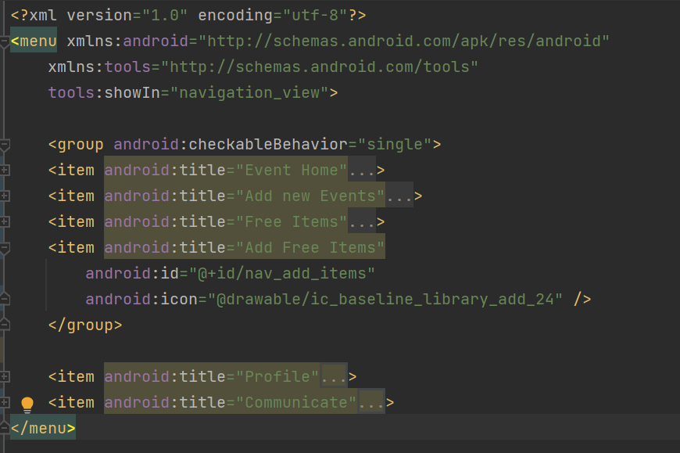
Action Bar (Navigation Bar)
Fig. 3: Menu items XML code

Slide 8
Database: Back4App
Store and query relational data on the cloud. Make it accessible over GraphQL and REST with a scalable, open-source backend.
Spin up a new database in minutes with Back4App.
Effortlessly define your relational data model using either our intuitive UI or programmatically via GraphQL, REST, or SDKs.
Perform diverse queries using advanced resources: relational queries, geo-queries, constraints, and aggregates.
Fetch data from your application using GraphQL, REST or your preferred SDK.
Its automatically generated APIs include endpoints for all operations and make easy for us to interact with all backend features with few lines of code.

Slide 9
Back4App: Parse Object Create Query
createBtn.setOnClickListener( v -> { try{ ParseObject eventObject = new ParseObject("Events"); // Store an object eventObject.put("eventName",eNameET.getText().toString()); eventObject.put("eventDescription",eDescET.getText().toString()); eventObject.put("eventNotes",eNotesET.getText().toString()); eventObject.put("eventAddressLine1",eAddLine1ET.getText().toString()); eventObject.put("eventAddressLine2",eAddLine2ET.getText().toString()); eventObject.put("eventCity",eCityET.getText().toString()); eventObject.put("eventState",eStateET.getText().toString()); eventObject.put("eventCountry",eCountryET.getText().toString()); eventObject.put("eventZipcode",eZipET.getText().toString()); String stDateTime=eStDtET.getText().toString(); String endDateTime=eEndDtET.getText().toString(); DateFormat formatter=new SimpleDateFormat("MM/dd/yyyy HH:mm"); Date stdate=formatter.parse(stDateTime); Date etdate=formatter.parse(endDateTime); eventObject.put("eventStartDt",stdate); eventObject.put("eventEndDt", etdate);
Fig. 4.1: Create Query Part-1

Slide 10
Back4App: Parse Object Create Query
// Saving object eventObject.saveInBackground(new SaveCallback() { @Override public void done(ParseException e) { progressDialog.dismiss(); if (e == null) { // Success showAlert("Successfully saved..!\n", "Your object has been saved in Events class."); } else { // Error Toast.makeText(CreateEventActivity.this, e.getMessage(), Toast.LENGTH_LONG).show(); } } }); }catch (Exception e){ Toast.makeText(CreateEventActivity.this, e.getMessage(), Toast.LENGTH_LONG).show(); } }); }
Fig. 4.2: Create Query part-2

Slide 11
Back4App: Parse Object Read Query
// Read Parse Objects
ParseQuery<ParseObject> query = ParseQuery.getQuery("Events");
query.whereGreaterThanOrEqualTo("eventStartDt", dateToday); query.findInBackground(new FindCallback<ParseObject>() { @Override public void done(List<ParseObject> results, ParseException e) { for (ParseObject eventObj : results) { if (e == null) { String eventID, eventName, eventStDT, eventEndDt, eventDescription,eventAddressLine1, eventAddressLine2, eventCity,eventState, eventCountry, eventZipcode, eventNotes; eventID= eventObj.getObjectId(); eventName = eventObj.getString("eventName"); eventStDT = String.valueOf(eventObj.getDate("eventStartDt")); eventEndDt = String.valueOf(eventObj.getDate("eventEndDt")); eventDescription = eventObj.getString("eventDescription"); eventAddressLine1 = eventObj.getString("eventAddressLine1") ; eventAddressLine2 = eventObj.getString("eventAddressLine2"); eventCity= eventObj.getString("eventCity") ; eventState= eventObj.getString("eventState") ; eventCountry= eventObj.getString("eventCountry"); eventZipcode= eventObj.getString("eventZipcode") ; eventNotes = eventObj.getString("eventNotes"); Log.v("ObjectID",String.valueOf(eventID)); myEModel.eventsList.add(new EventModel.Events(eventID, eventName, eventStDT, eventEndDt, eventDescription, eventAddressLine1, eventAddressLine2, eventCity, eventState, eventCountry, eventZipcode, eventNotes));
Fig. 5: Read Query

Slide 12
Back4App: ParseObject Update Query
ParseQuery<ParseObject> query = ParseQuery.getQuery("Events"); // Retrieve the object by id query.getInBackground(fetchID, new GetCallback<ParseObject>() { public void done(ParseObject eventObject, ParseException e) { if (e == null) { eventObject.put("eventName",eNameET.getText().toString()); eventObject.put("eventDescription",eDescET.getText().toString()); eventObject.put("eventNotes",eNotesET.getText().toString()); eventObject.put("eventAddressLine1",eAddLine1ET.getText().toString()); eventObject.put("eventAddressLine2",eAddLine2ET.getText().toString()); eventObject.put("eventCity",eCityET.getText().toString()); eventObject.put("eventState",eStateET.getText().toString()); eventObject.put("eventCountry",eCountryET.getText().toString()); eventObject.put("eventZipcode",eZipET.getText().toString()); String stDateTime=eStDtET.getText().toString(); String endDateTime=eEndDtET.getText().toString(); DateFormat formatter=new SimpleDateFormat("MM/dd/yyyy HH:mm"); Date stdate= null; Date etdate= null;
Fig. 6.1: Update Query part-1

Slide 13
Back4App: Parse Object Update Query
try { stdate = formatter.parse(stDateTime); }
catch (java.text.ParseException ex) { Log.v("StartDate Ex:", ex.getMessage()); } try { etdate = formatter.parse(endDateTime); }
catch (java.text.ParseException ex) { Log.v("endDate Ex:", ex.getMessage()); } eventObject.put("eventStartDt",stdate); eventObject.put("eventEndDt", etdate); // Saving object eventObject.saveInBackground(new SaveCallback() { @Override public void done(ParseException e) { progressDialog.dismiss(); if (e == null) { // Success showAlert("Successfully saved..!\n", "Your object has been saved in Events class."); } else { // Error Toast.makeText(UpdateEventActivity.this, e.getMessage(), Toast.LENGTH_LONG).show(); } } }); } else { // Failed
Toast.makeText(UpdateEventActivity.this, e.getMessage(), Toast.LENGTH_LONG).show(); } } });
Fig. 6.2: Update Query part-2

Slide 14
Back4App: Parse Object Delete Query
ParseQuery<ParseObject> eventObjects = ParseQuery.getQuery("Events"); // Query parameters based on the item name eventObjects.whereEqualTo("objectId", fetchID); eventObjects.findInBackground(new FindCallback<ParseObject>() { @Override public void done(final List<ParseObject> event, ParseException e) { if (e == null) { event.get(0).deleteInBackground(new DeleteCallback() { @Override public void done(ParseException e) { if (e == null) { showAlert("Delete Status:", "Object has been deleted Successfully"); }
else { Log.v("Delete Inner Ex:",e.getMessage()); } } }); }else { Log.v("Delete Parse Outer Ex: ",e.getMessage()); } }
Fig. 7: Delete Query

Slide 15
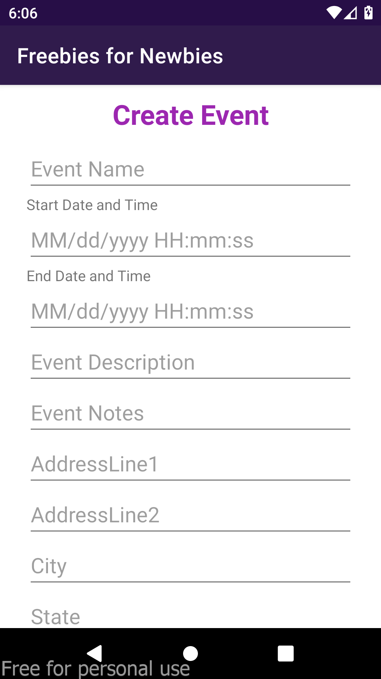
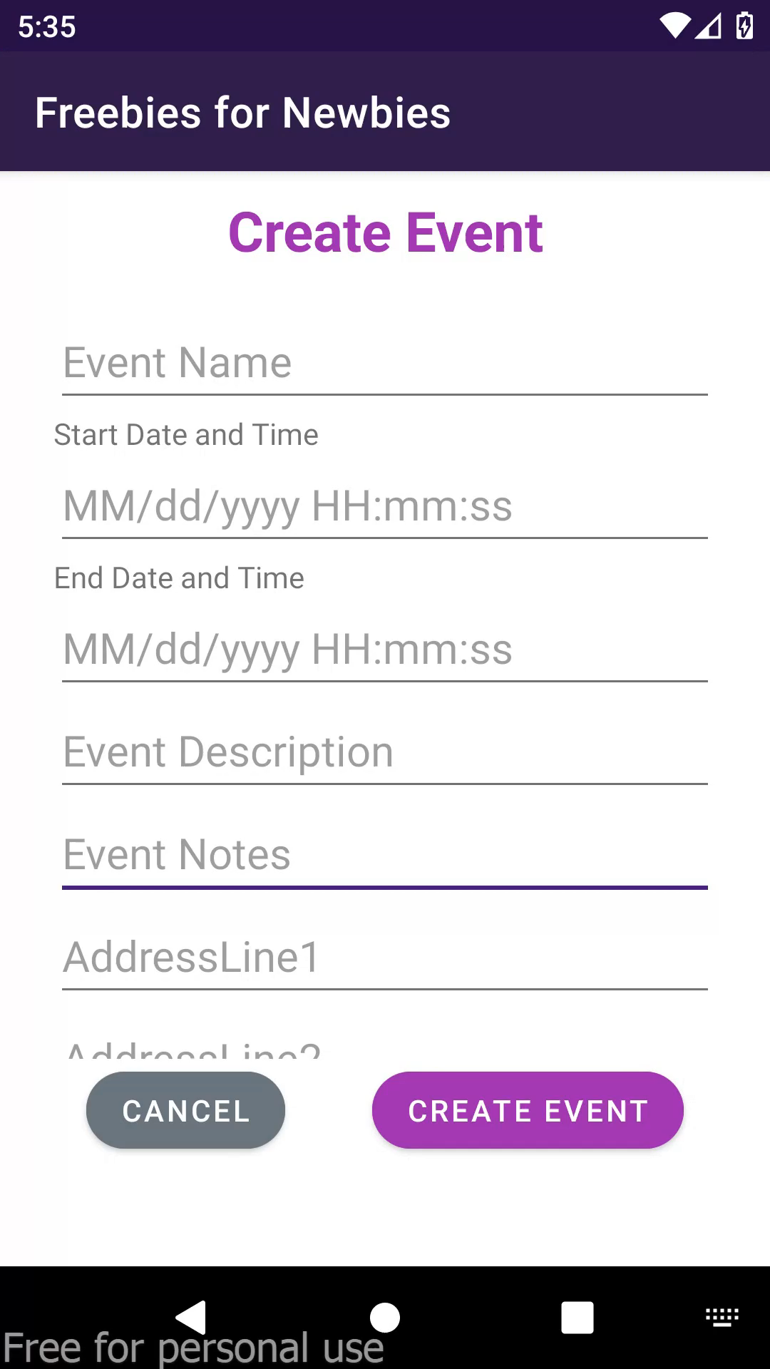
Scroll View
Scroll View is easy to use, but it's not recommended for long, scrollable lists. In that scenario, we use Recyclable views.
Fig. 8: Without ScrollView
Video 1: Using ScrollView

Slide 16
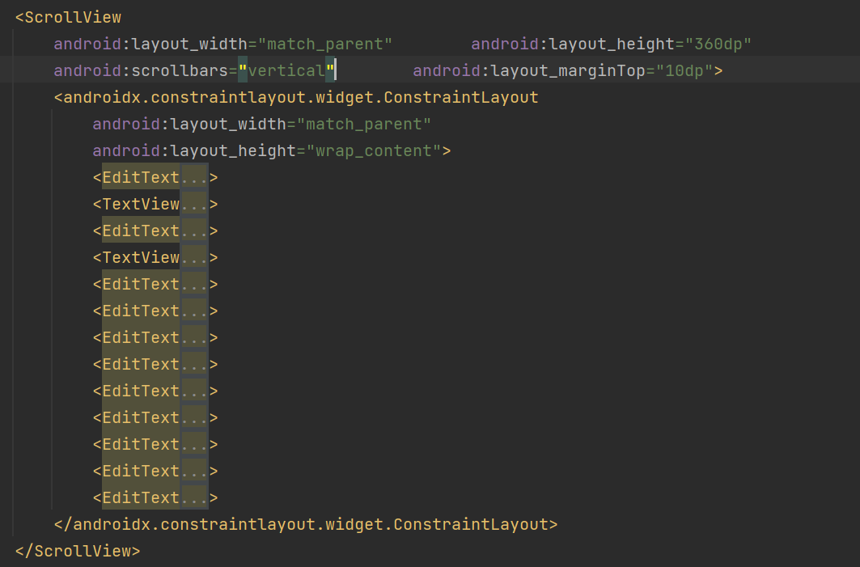
Scroll View
Fig. 9: ScrollView XML code

Slide 17
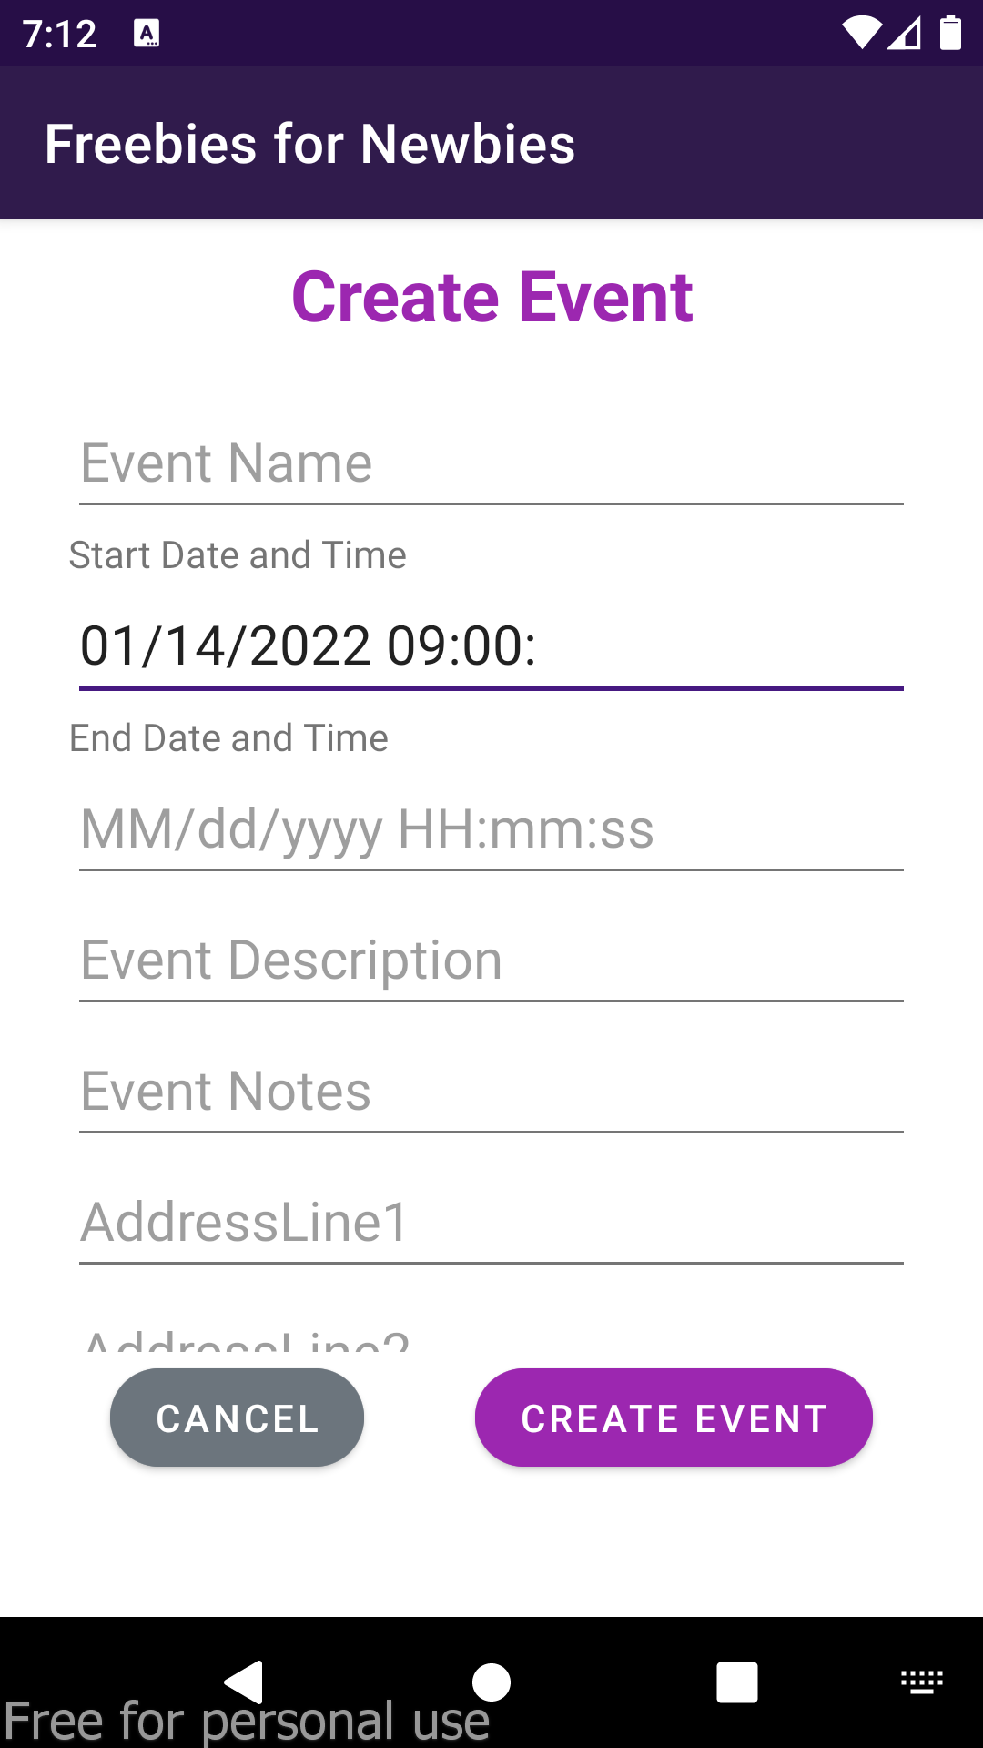
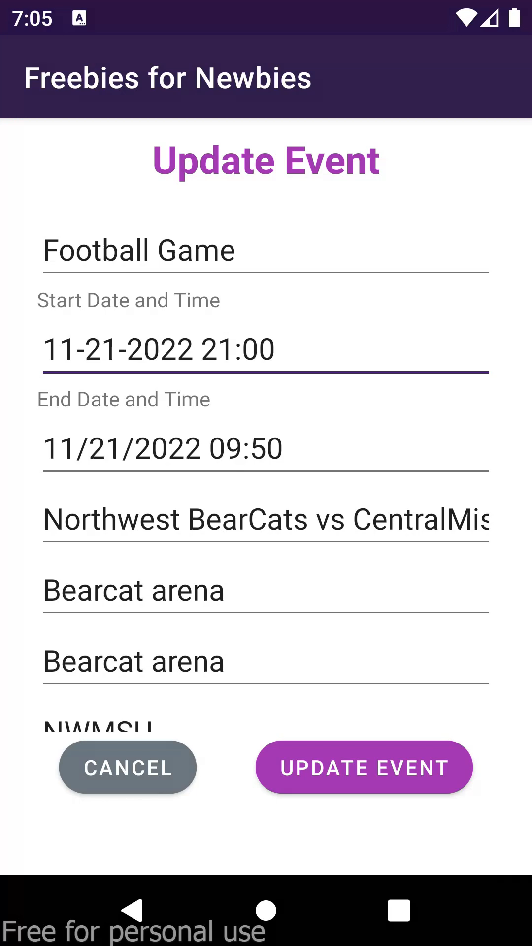
Date Picker & Time Picker
Date Picker and Time Picker are both dialogues which prompt on the screen when an action is pressed .
Fig. 10: Before Date &Time Picker
Video 2: After using Date &Time Picker

Slide 18
Date Picker & Time Picker
private void showDateTimeDialog(EditText date_time_in){ Calendar calendar=Calendar.getInstance(); DatePickerDialog.OnDateSetListener dateSetListener=new DatePickerDialog.OnDateSetListener() { @Override public void onDateSet(DatePicker datePicker, int year, int month, int dayOfMonth) { calendar.set(Calendar.YEAR,year); calendar.set(Calendar.MONTH,month); calendar.set(Calendar.DAY_OF_MONTH,dayOfMonth); TimePickerDialog.OnTimeSetListener timeSetListener= new TimePickerDialog.OnTimeSetListener() { @Override public void onTimeSet(TimePicker eCityET.getText, int hourOfDay, int minute) { calendar.set(Calendar.HOUR_OF_DAY,hourOfDay); calendar.set(Calendar.MINUTE,minute); SimpleDateFormat simpleDateFormat = new SimpleDateFormat("MM-dd-yyyy HH:mm"); date_time_in.setText(simpleDateFormat.format(calendar.getTime())); } };new TimePickerDialog(UpdateEventActivity.this,timeSetListener,calendar.get(Calendar.HOUR_OF_DAY),calendar.get(Calendar.MINUTE),false).show(); } }; new DatePickerDialog(UpdateEventActivity.this,dateSetListener,calendar.get(Calendar.YEAR),calendar.get(Calendar.MONTH),calendar.get(Calendar.DAY_OF_MONTH)).show(); }
Fig. 11: DateTimeDialog Java code

Slide 19
RecyclerViews
A single column table, aka a vertically scrolling, horizontally filled list of Views. This is a more flexible/advanced version of a ListView.
RecyclerView makes it easy to efficiently display large sets of data.
<androidx.recyclerview.widget.RecyclerView android:id="@+id/eventRecyclerView" android:layout_width="match_parent" android:layout_height="match_parent" android:layout_marginTop="112dp" app:layout_constraintTop_toTopOf="parent" app:layout_constraintEnd_toEndOf="parent" app:layout_constraintStart_toStartOf="parent" app:layout_constraintBottom_toBottomOf="parent"/>
Fig. 12.1: RecyclerView in XML file

Slide 20
RecyclerView: Data Model
package sec03team05fall22gdp.org.freebiesfornewbies; import java.util.ArrayList; public class EventModel { public static class Events{ public String eventID, eventName, eventStDT, eventEndDt,eventDescription ,eventAddressLine1, eventAddressLine2, eventCity,eventState, eventCountry, eventZipcode, eventNotes; public Events(String eventID, String eventName, String eventStDT, String eventEndDt, String eventDescription, String eventAddressLine1, String eventAddressLine2, String eventCity, String eventState, String eventCountry, String eventZipcode, String eventNotes) { this.eventID = eventID; this.eventName = eventName; this.eventStDT = eventStDT; this.eventEndDt = eventEndDt; this.eventDescription = eventDescription; this.eventAddressLine1 = eventAddressLine1; this.eventAddressLine2 = eventAddressLine2; this.eventCity = eventCity; this.eventState = eventState; this.eventCountry = eventCountry; this.eventZipcode = eventZipcode; this.eventNotes = eventNotes; } } private static EventModel theModel = null; public static EventModel getSingleton(){ theModel = new EventModel(); return theModel; } public ArrayList<Events> eventsList; private EventModel(){ eventsList = new ArrayList<Events>(); } }
Fig.12.2: Data Model

Slide 21
RecyclerView: Adapter
public class EventRAdapter extends RecyclerView.Adapter<EventRAdapter.MyViewHolder> { Context context; private EventModel myModel; public EventRAdapter(Context context, EventModel myModel){ this.context= context; this.myModel = myModel; } public static class MyViewHolder extends RecyclerView.ViewHolder{ TextView tvEventName, tvEventStartDT, tvEventEndDT, tvEventLocation, tvEventDesc; public MyViewHolder(@NonNull View itemView) { super(itemView); tvEventName = itemView.findViewById(R.id.tvEvent); tvEventStartDT = itemView.findViewById(R.id.tvEventStDt); tvEventEndDT = itemView.findViewById(R.id.tvEventEndDt); tvEventLocation = itemView.findViewById(R.id.tvEventLoc); tvEventDesc = itemView.findViewById(R.id.tvEventDesc); } }
Fig. 12.3: Adapter class part-1

Slide 22
RecyclerView: Adapter
@NonNull @Override public EventRAdapter.MyViewHolder onCreateViewHolder(@NonNull ViewGroup parent, int viewType) { LayoutInflater inflater = LayoutInflater.from(context); View view = inflater.inflate(R.layout.event_recylcerview_row,parent,false); return new EventRAdapter.MyViewHolder(view); } @Override public void onBindViewHolder(@NonNull EventRAdapter.MyViewHolder holder, int position) { holder.tvEventName.setText(myModel.eventsList.get(position).eventName); holder.tvEventStartDT.setText(myModel.eventsList.get(position).eventStDT); holder.tvEventEndDT.setText(myModel.eventsList.get(position).eventEndDt); String eLocation = myModel.eventsList.get(position).eventAddressLine1+", " +myModel.eventsList.get(position).eventCity+ ", “ +myModel.eventsList.get(position).eventState+“p"+myModel.eventsList.get(position).eventZipcode; holder.tvEventLocation.setText(eLocation); holder.tvEventDesc.setText(myModel.eventsList.get(position).eventDescription); } @Override public int getItemCount() { return myModel.eventsList.size(); } }
Fig. 12.4: Adapter class part-2

Slide 23
RecyclerView: Activity.java
private EventModel myEModel ;private RecyclerView recyclerView=null; private EventRAdapter adapter = null;private GestureDetectorCompat detector = null;
adapter = new EventRAdapter(HomeActivity.this, myEModel);
recyclerView = findViewById(R.id.eventRecyclerView); recyclerView.setAdapter(adapter); recyclerView.setLayoutManager(new LinearLayoutManager(HomeActivity.this));
detector = new GestureDetectorCompat(HomeActivity.this, new RecyclerViewOnGestureListener());
recyclerView.addOnItemTouchListener(new RecyclerView.SimpleOnItemTouchListener(){ @Override public boolean onInterceptTouchEvent(RecyclerView rv, MotionEvent e) { return detector.onTouchEvent(e); } });
Fig. 12.5: Activity.java file part-1

Slide 24
RecyclerView: Activity.java
private class RecyclerViewOnGestureListener extends GestureDetector.SimpleOnGestureListener { @Override public boolean onSingleTapConfirmed(MotionEvent e) { View view = recyclerView.findChildViewUnder(e.getX(), e.getY()); if (view != null) { RecyclerView.ViewHolder holder = recyclerView.getChildViewHolder(view); if (holder instanceof EventRAdapter.MyViewHolder) { int position = holder.getAdapterPosition(); // handle single tap String sEventId= myEModel.eventsList.get(position).eventID; Log.v("Selected EventID: ",sEventId); Intent intent = new Intent(HomeActivity.this, DetailedEventActivity.class); intent.putExtra("eventID",sEventId); startActivity(intent); return true; // Use up the tap gesture } } // we didn't handle the gesture so pass it on return false; } }
Fig. 12.6: Activity.java file part-2

Slide 25
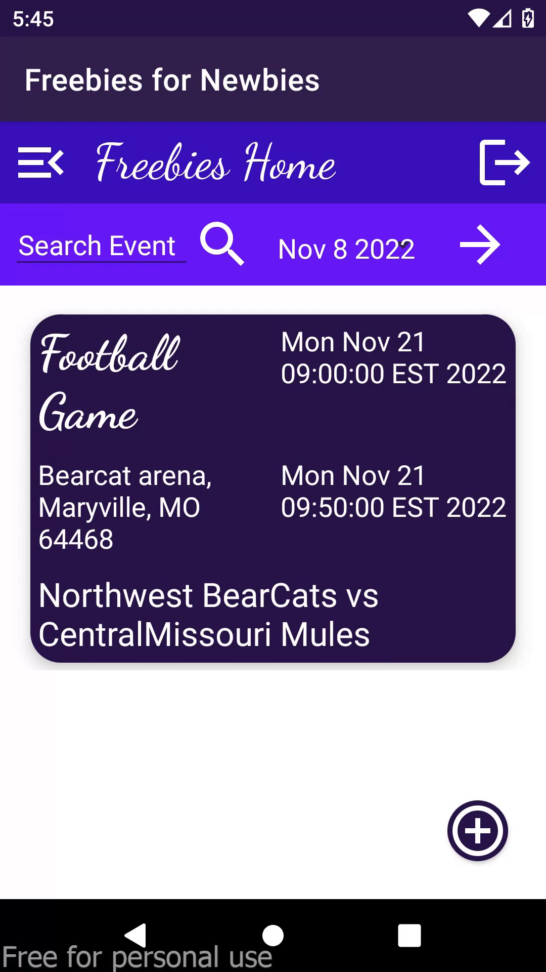
RecyclerView: Working Demo
Video 3: RecyclerView working demo

Slide 26
Lessons Learned
There is a process-scope limit of 1MB of data being passed between components. Please keep in mind that this does not mean that you can pass 1MB of data safely, as there may be multiple Intents being processed at a time.
If an event causes the model to change, the Adapter needs to notify the RecyclerView so that it can change the view inside any affected ViewHolders.
Example: notifyDataSetChanged() - Redo it all.
notifyItemChanged(int position) - Contents of a particular value has changed.
and few more other methods.

Slide 27
Summary
In this presentation, we covered the topics that we have learned after the midterm1, mainly RecyclerView, Adapters, ScrollViews, Intents, Parse Queries etc.
We have given few examples for each topic to have a clear understandings.
We discussed few limitations on the intents and other components used.

Slide 28
References
Image sources:
Back4App: https://www.back4app.com/
Android Studio: https://developer.android.com/studio
GenyMotion: https://www.genymotion.com/
VirtualBox: https://commons.wikimedia.org/wiki/File:Virtualbox_logo.png
Project linkss:
https://github.com/Sec03Team05Fall22GDP1/FreebiesforNewbies

Slide 29
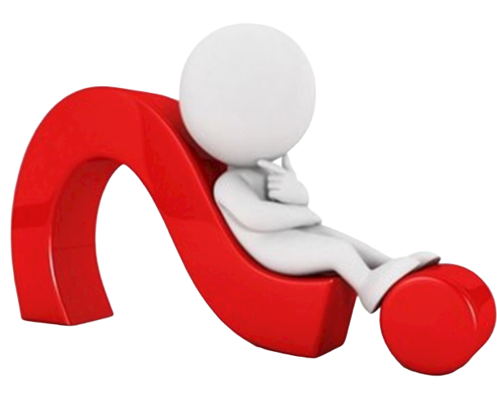
Thank You Everyone..!
Any Queries..?

Slide 30
Team Members
JAICHAND MULAKALAPALLI
(TEAM LEADER) BACKEND
MANOJ KUMAR GUDE
FRONTEND
ADITHYA KRISHNA RAAVI
FRONTEND
Saibabu devarapalli
Fullstack
HARISH CHOWDARY BALA
DATABASE
DR. CHANDRA MOULI KOTTETI
Mentor & Client

Slide 31
FREEBIES FOR NEWBIES
A place to find free event and items
Team Members:
Aditya Krishna Raavi
Manoj Kumar Gude
Harish Chowdary Bala
Saibabu Devarapalli
Jaichand Mulakalapalli
Client & Mentor:
Dr. Chandra Mouli Kotteti

